Slide 1

Overview

Slide 2
Contents
Why R?
What is R?
General pros and cons
RStudio IDE
Graphics
Markdown
Shiny
Conclusions

Slide 3

Quiz
How old is R?
What language(s) is R derived from?
Who is Chief Data Scientist at Rstudio?
What is the tidyverse?
What is CRAN?

Slide 4
What is R
Similar to the S language and environment which was developed at Bell Laboratories (formerly AT&T, now Lucent Technologies) by John Chambers and colleagues
R can be considered as a different implementation of S. There are some important differences though
From its origins as a mainly scripting language for statistics its has develop in recent years to be much more
This does mean that it has some quirks and idiosyncrasies!

Slide 5

R’s popularity
R is a free, open source high-level software program
R is arguably the go-to software for data science and statistics
R provides a wide variety of statistical (linear and nonlinear modelling, classical statistical tests, time-series analysis, classification, clustering, …) and graphical techniques
Ease with which well-designed publication-quality plots can be produced, including mathematical symbols and formulae where needed

Slide 6
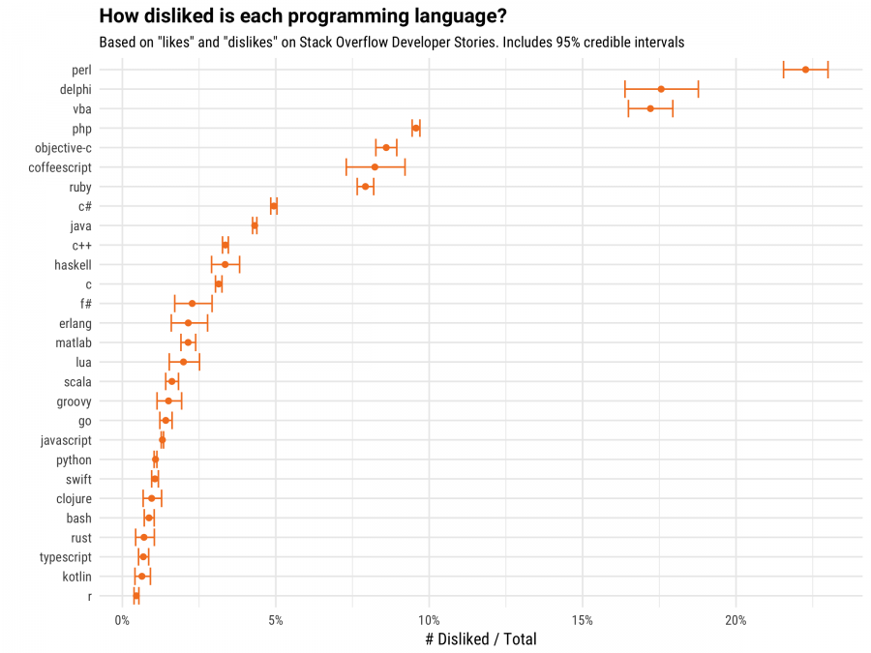
https://stackoverflow.blog/2017/10/31/disliked-programming-languages/

Slide 7
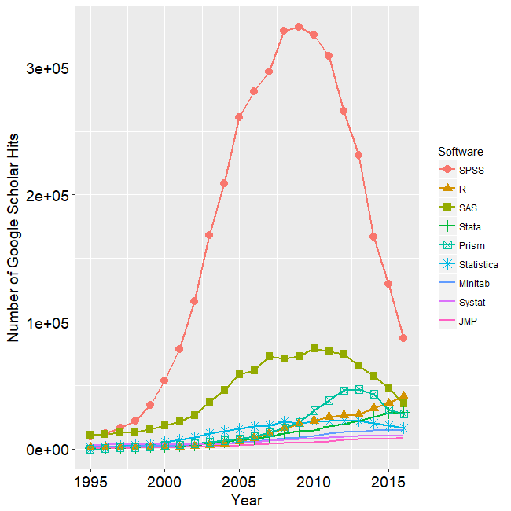
https://r4stats.com/2014/08/20/r-passes-spss-in-scholarly-use-stata-growing-rapidly/

Slide 8
General Pros
Free and open source.
Available for Windows, Macintosh, and Linux
Publication-quality graphs
Rivals (and in many cases, exceeds) SAS and Stata in terms of availability of advanced statistical methods and algorithms, through availability of user-created packages
Packages for literate statistical programming - weaving written reports and analysis code in one document
Simple syntax
Interacts with other software, including Excel, C, Python, SQL, stan, WinBUGs and others

Slide 9
General pros
R uses command-line scripting, which is ideal for storing numerous series of complex data-analysis and recycling that analysis' on similar sets of data
Upgrades to the software are much more regular
This is extremely advantageous for statistical programming languages and environments
R's large and active online community supply a myriad of documentation, tutorials and online query forums
It is now supplemented by more than 8000 community developed open- source packages available for download from The Comprehensive R Archive Network (CRAN)
Authors often supplement the package submission with a publication in the Journal of Statistical Software, with more rigorous documentation and relevant theoretical material

Slide 10
General pros
Profiling tools examine program performance and aid speeding up run times
Debugging tools enable faster, less stressful bug fixes
Similar to MATLAB (expensive)

Slide 11
General Cons
Programming is required!
Is relatively slow, e.g. loops, to other lower level programming languages e.g. C
but can leverage this by linking with them
Some of its structure/behaviour can be surprising for people coming from other programming languages
People just may be more comfortable with analyses in something other than R

Slide 12
RStudio
RStudio is a free and open-source integrated development environment (IDE) for R, a programming language for statistical computing and graphics
RStudio is available in open source and commercial editions and runs on the desktop (Windows, macOS, and Linux)
Its interface is organized so that the user can clearly view graphs, data tables, R code, and output all at the same time
Also offers an Import-Wizard-like feature that allows users to import CSV, Excel, SAS (*.sas7bdat), SPSS (*.sav), and Stata (*.dta) files into R without having to write the code to do so.

Slide 13
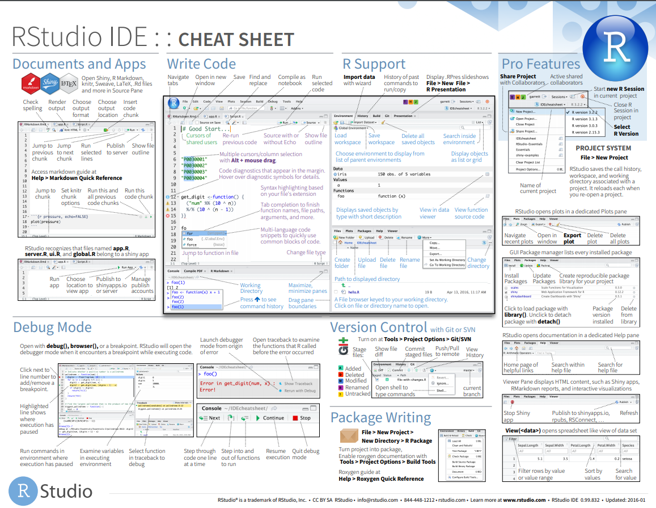

Slide 14
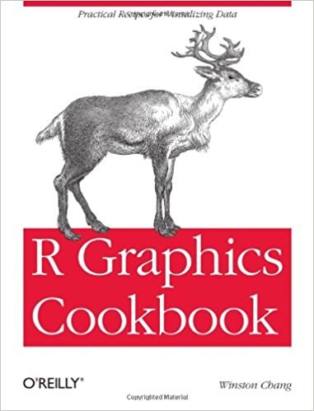
Graphics
R comes with great abilities in data visualization, should the visualization be static, interactive and even far more complicated
ggplot2: “the grammar of graphics”

Slide 15
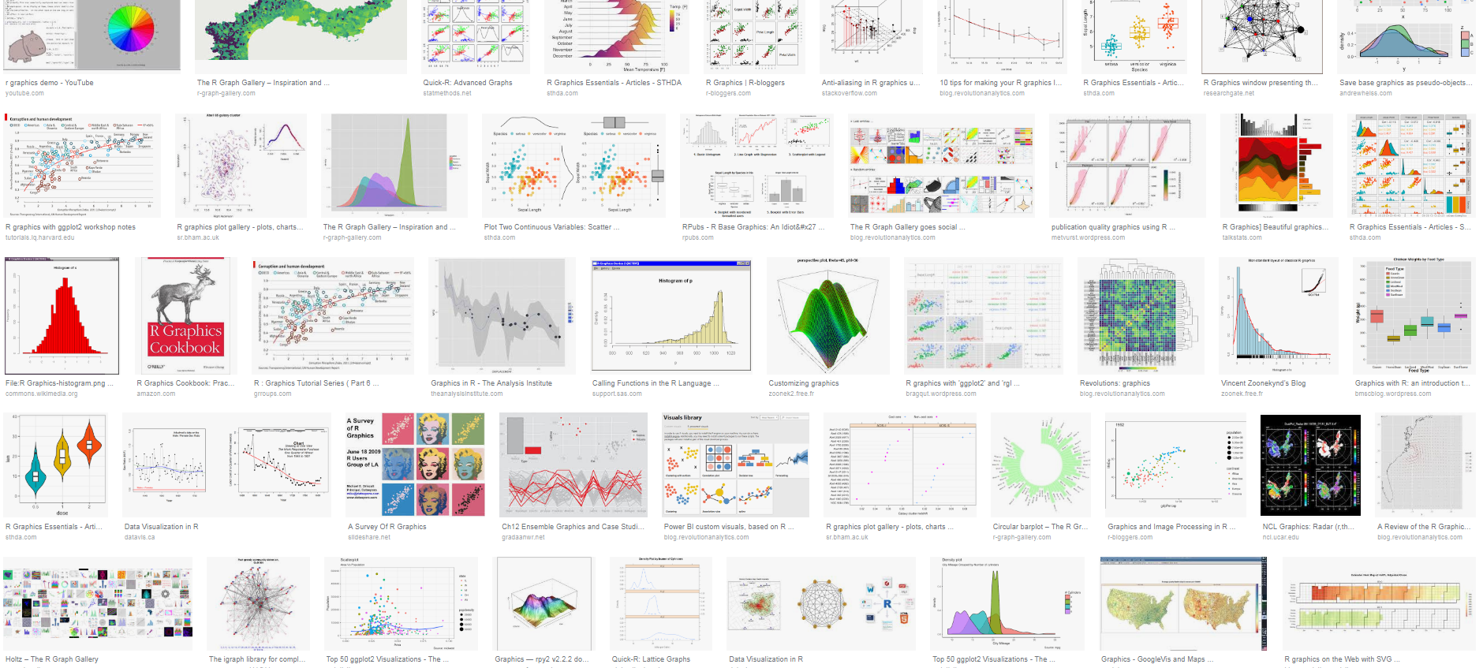

Slide 16


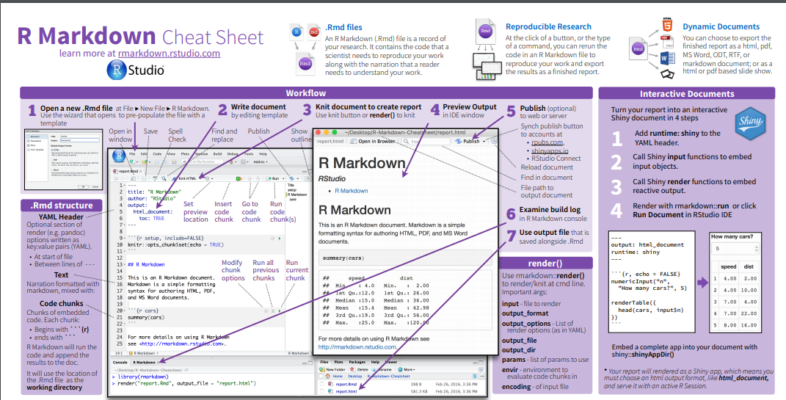
Markdown

Slide 17

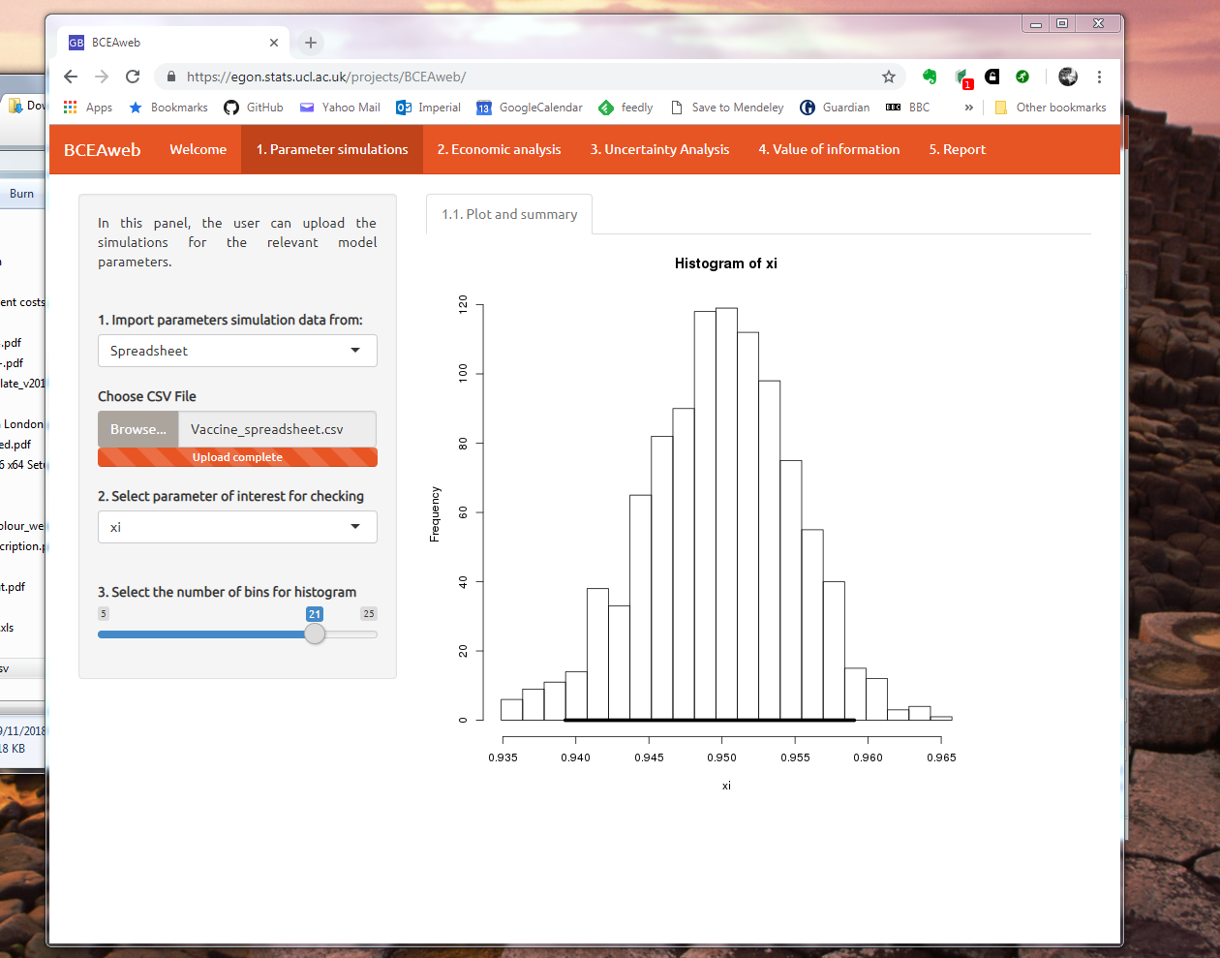
Shiny
Shiny is an R package that makes it easy to build interactive web apps straight from R
You can
host standalone apps on a webpage
embed them in R Markdown documents
build dashboards
You can also extend your Shiny apps with CSS themes, htmlwidgets, and JavaScript actions.
BCEAweb

